Slide 1

Tree Species Image Classification & Live Web Demo
A Comprehensive Approach to Fine-Grained Plant Recognition
Presenter: Manish Kumar Gupta

Slide 2
The Challenge: Fine-Grained Tree Classification
Accurately identifying tree species presents several complex challenges, especially when dealing with a large number of visually similar species and real-world conditions.
Visual Similarity
Limited Data
Distinguishing between 29 visually similar tree species, where subtle differences in leaf, bark, or overall shape are critical.
Working with a constrained dataset, which significantly increases the risk of model overfitting and poor generalization.
Noisy Images
Non-Tree Rejection
Handling real-world images that include complex backgrounds, varied lighting conditions, and potential occlusions.
Ensuring the model can accurately reject non-tree images to provide robust and reliable predictions, preventing misclassifications of irrelevant inputs.

Slide 3
Core Objectives
Our project aims to overcome these challenges by focusing on key objectives that combine machine learning accuracy with practical application.
1
Develop an Accurate and Robust Model
2
Create a User-Friendly Tool
Our primary goal is to create a highly accurate deep learning model capable of reliable tree species identification, even under diverse conditions.
We aim to build a practical, intuitive web application that supports forest surveys, ecological research, and citizen science initiatives.
3
Achieve High Performance Benchmarks
4
Implement Robust Rejection
We targeted a strong performance benchmark, specifically a Macro-F1 score exceeding 75%, to ensure real-world utility.
A crucial objective is to integrate a reliable system for rejecting non-tree images, making the application dependable for diverse inputs.

Slide 4
A Multi-Faceted Approach
Our methodology combines rigorous data preparation, advanced model training, and intuitive web development to create a comprehensive solution.
Data & Augmentation
Model Training & Optimization
Acquired and meticulously curated a specialized dataset covering 29 distinct tree species.
Trained a basic Convolutional Neural Network (CNN) from scratch as a baseline for comparison.
Applied extensive data augmentation techniques (e.g., rotations, flips, zooms) to enhance dataset diversity and improve model generalization, preventing overfitting on limited data.
Leveraged transfer learning with pre-trained MobileNetV2 and EfficientNetV2-B0 models, implementing both head-only and full fine-tuning strategies.
Employed advanced optimization callbacks such as EarlyStopping and ReduceLROnPlateau to fine-tune training and prevent performance plateaus.
Finally, we developed an intuitive, lightweight Flask and Tailwind CSS web application, complete with drag-and-drop functionality and live prediction previews.

Slide 5

Tools and Technologies
Our project leveraged a robust stack of cutting-edge tools and frameworks for deep learning and web development.
Deep Learning Ecosystem
Web Application & Development
Language: Python 3.11 for all machine learning tasks.
Backend: Flask 3.0.3 for a lightweight and scalable web server.
Frameworks: TensorFlow 2.15 and Keras for building and training neural networks.
Frontend: HTML5, Tailwind CSS for modern and responsive UI, and JavaScript for interactive elements.
Libraries: OpenCV for image processing, Pillow for image manipulation, and Albumentations for efficient data augmentation.
Development Environment: Google Colab (utilizing T4 GPU for accelerated training) and VS Code for efficient code development.
Model Hosting: Google Drive for secure and accessible storage of large model files.

Slide 6
Model Performance Comparison
Our rigorous testing and comparison of different models clearly demonstrate the superior performance of transfer learning, especially with EfficientNetV2-B0.
CNN (Scratch)
1.2 M
26.9 %
0.24
—
MobileNetV2 (head-only)
2.2 M
68.4 %
0.68
87 %
MobileNetV2 (fine-tuned, SGD)
2.4 M
69.7 %
0.68
89 %
MobileNetV2 (fine-tuned, AdamW)
2.4 M
72.1 %
0.68
90 %
EfficientNetV2-B0 (head-only)
4.2 M
76.5 %
0.70
94 %
EfficientNetV2-B0 (fine-tuned)
4.2 M
77.2 %
0.70
96 %
The EfficientNetV2-B0 (fine-tuned) model emerged as the clear winner, achieving the highest validation accuracy and top-3 accuracy, underscoring the significant benefits of fine-tuning powerful pre-trained models for specialized tasks.

Slide 7
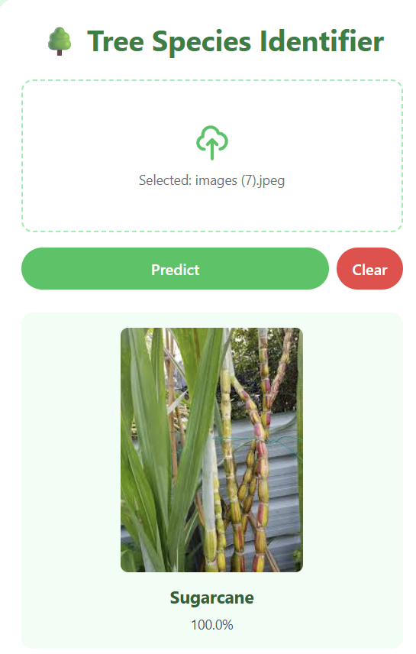
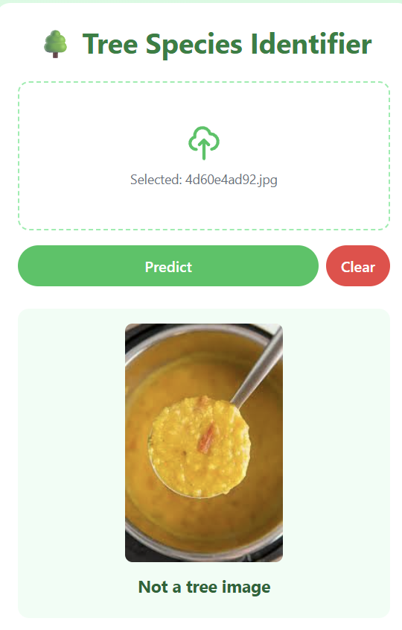
Live Demo: The Web Application in Action
Our user-friendly web application provides real-time tree species identification with robust rejection capabilities. Users can simply drag and drop images for instant analysis.
Successful Classification: The application accurately identifies "Mountain Ebony" with high confidence, displaying the predicted species name and confidence score clearly. Robust Rejection: The system intelligently classifies an unrelated input (e.g., a hand) as "Not a tree image," demonstrating its ability to distinguish between relevant and irrelevant visual data.

Slide 8


Project Summary & Achievements
We successfully developed a highly performant and practical solution for tree species identification, moving from complex deep learning challenges to a deployable web application.
Superior Performance
Enhanced Robustness
Practical Deployment
Achieved an impressive 77.2% validation accuracy and a 70% macro-F1 score, exceeding initial benchmarks for fine-grained classification.
Successfully implemented a reliable and efficient system for rejecting non-tree images, ensuring cleaner and more dependable predictions in real-world scenarios.
Delivered a lightweight, responsive, and intuitive web application ready for practical use in forest surveys and citizen science initiatives, making advanced AI accessible.

Slide 9

Future Work & Roadmap
Our project lays a strong foundation for future enhancements, aiming to expand dataset coverage and integrate advanced functionalities for broader utility.
Mobile Deployment
Geo-tagging Integration
Optimize and export the deep learning model to TensorFlow Lite, enabling seamless integration into a dedicated mobile application for on-the-go tree identification.
Dataset Expansion
Implement geo-tagging capabilities with predictions, allowing for live mapping of identified tree species and enhanced ecological monitoring.
Expand the existing dataset to include more tree species, as well as images captured across different seasons and from drone perspectives for comprehensive applicability.

Slide 10

Thank You!
We appreciate your time and attention. We are confident that this project offers a robust solution for tree species classification, with significant potential for future development and real-world impact.
For any questions or further discussions, please contact Manish Kumar Gupta.

